Slide 1
STRINGS

Slide 2
Agenda
Introduction
Declaration & Initialization
Reading & Printing Strings
Arithmetic Operations on characters
String Handling Functions
Table of Strings
References

Slide 3
Introduction
String can be represented as a single-dimensional character type array.
C language does not provide the intrinsic string types.
Strings in C are group of characters, digits, and symbols enclosed in quotation marks or simply we can say the string is declared as a “character array”.
The end of the string is marked with a special character, the ‘\0’ (Null character), which has the decimal value 0.

Slide 4
There is a difference between a character stored in memory and a single character string stored in a memory.
The character requires only one byte whereas the single character string requires two bytes (one byte for the character and other byte for the delimiter).
The string functions operate on null-terminated arrays of characters and require the header <string.h>.

Slide 5
Introduction
A string is an array of characters.
Any group of characters defined between double quotation marks is a constant string
EXAMPLE: “Man is obviously made to think.”
To include a double quote in the string to be printed, use a back slash.
EXAMPLE: printf(“Well Done !”);
OUTPUT: Well Done!
EXAMPLE: printf(“\”Well Done!\””);
OUTPUT: “Well Done!”

Slide 6
Introduction
Common operations performed on strings are:
Reading and writing strings
Combining together
Copying one ststrings ring to another
Comparing strings for equality
Extracting a portion of a string
Reversing a string

Slide 7
Declaration
The syntax is: char string-name[size];
Examples:
char name[20];
char address[25];
char city[15];

Slide 8
DECLARING AND INITIALIZING STRING VARAIBLES
A string variable is any valid C variable name and is always declared as an array
SYNTAX: char string_name[size];
The size determines the number of characters in the string-name
EXAMPLE: char city[10];
When the compiler assigns a character string to a character array, it automatically supplies a null character (‘\0’) at the end of the string.
The size should be equal to the maximum number of characters in the string plus one.

Slide 9
DECLARING AND INITIALIZING STRING VARAIBLES
Character arrays may be initialized when they are declared
char city[9] = “NEW YORK”;
char city[9] = (‘N’,’E’,’W’,’ ‘,’Y’,’O’,’R’,’K’,’\0’);
When we initialize a character by listing its elements, we must supply the null terminator
Can initialize a character array without specifying the number of elements.

Slide 10
DECLARING AND INITIALIZING STRING VARAIBLES
The size of the array will be determined automatically, based on the number of elements initialized.
char string[ ] = {'G','O','O','D','\0'};
Can also declare the size much larger than the string size.
char str[10] = “GOOD”;
Following will result in a compile time error.
char str[3] = “GOOD”;
Eg:- char name[ 8] = {‘P’, ‘R’, ‘O’, ‘G’, ‘R’, ‘A’, ‘M’, '\0’};
P
R
O
G
R
A
M
\0
1001
1002
1003
1004
1005
1006
1007
1008

Slide 11
DECLARING AND INITIALIZING STRING VARAIBLES
We cannot separate the initialization from declaration
char str[5];
str = “GOOD”;
Following is not allowed
char s1[4]=”abc”;
char s2[4];
– s2 = s1;

Slide 12
DECLARING AND INITIALIZING STRING VARAIBLES
Reading words
The input function scanf can be used with %s format specification to read in a string of character.
char address[15];
scanf(“%s”, address);
The problem with the scanf function is that it terminates its input on the first white space it finds.
A white space include blanks, tabs, carriage returns, form feeds and new lines
INPUT: NEW YORK
Only the string “NEW” will be read into the array address.
In the case of character arrays, the ampersand (&) is not required before the variable name.
The scanf function automatically terminates the string with a null character.

Slide 13
EXAMPLE PROGRAM
#include<stdio.h>
int main ()
{
char greeting[6] = {'H', 'e', 'l', 'l', 'o', '\0’};
//OR
// char greeting[] = “Hello”;
printf("Greeting message: %s\n", greeting ); return 0;
}
OUTPUT:
Hello

Slide 14
READING STRING FROM TERMINAL
char line[80];
– scanf(“%s”,line);
printf(“%s”,line);
Will read a line of input from the keyboard and display the same on the screen.

Slide 15
PRINTING STRING PROGRAM1
main( )
{
char name[ ] = "Babbage" ;
int i = 0 ;
while ( i <= 6 )
{
printf ( "%c", name[i] ) ;
i++ ;
}
printf(“Using puts:”);
puts(name);
}
OUTPUT:
Babbage
Using puts:Babbage

Slide 16
PRINTING STRING PROGRAM2
main( )
{
char name[ ] = "Babbage" ;
int i = 0 ;
while ( name[i]!=‘\0’ )
{
printf ( "%c", name[i] ) ;
i++ ;
}
}
OUTPUT:
Babbage

Slide 17
EXAMPLE PROGRAM
#include <stdio.h>
main()
{
char line[100];
int i=0;
printf("Enter Text:\n");
do
{
line[i]=getchar();
i++;
} while(line[i-1] != '\n');
line[i] = '\0';
printf("\n%s\n",line);
}
OUTPUT:
Enter Text
String Programs
String Programs

Slide 18
READING A LINE OF TEXT
For reading string of text containing whitespaces is to use the library function gets available in the <stdio.h>
gets(str)
It reads characters into str from the keyboard until a new-line character is encountered and then appends a null character to the string.
char line[80];
gets(line);
printf(“%s”,line);
The last two statements may be combined as:
printf(“%s”,gets(line));

Slide 19
READING A LINE OF TEXT
Does not check array-bounds, so do not input more characters, it may cause problems.
C does not provide operators that work on strings directly.
We cannot assign one string to another directly.
string2 = “ABC”
string1 = string2;
Are not valid.
To copy the characters in string2 into sting1, we may do so on a character-by-character basis.

Slide 20
EXAMPLE PROGRAM
#include<stdio.h> main()
{
char string1[30], string2[30];
int i;
printf("Enter a string Str2:"); scanf("%s",string2); for(i=0;string2[i]!='\0';i++)
string1[i]=string2[i];
string1[i] = '\0';
printf("\n"); printf("Str1:%s\n",string1);
printf("Number of characters = %d\n",i);
}
OUTPUT
Enter a string Str2:Europe
Str1: Europe
Number of characters =6

Slide 21
WRITING STRINGS TO SCREEN
The printf function with %s format is used to print strings to the screen.
The format %s can be used to display an array of characters that is terminated by the null character.
printf(“%s”, name);
This display the entire content of the array name.

Slide 22
USING PUTCHAR AND PUTS
C supports putchar to output the values of character variables.
char ch = 'A';
putchar(ch);
This statement is equivalent to
printf(“%c”,ch);
Can use this function repeatedly to output string of characters stored in an array using a loop.
char name[6] = “PARIS”;
for(i=0;i<5;i++)
putchar(name[i]);
putchar(“\n”);

Slide 23
USING PUTCHAR AND PUTS
To print the string values is to use the function puts declared in the header file <stdio.h>
puts(str);
str is a string variable containing a string value.
This printf the value of the string variable str and then moves the cursor to the beginning of the next line on the screen.
char line[80]; gets(line);
puts(line);
Reads a line of text from the keyboard and display it on the screen.

Slide 24
PUTTING STRINGS TOGETHER
We cannot assign the string to another directly.
We cannot join two strings together by the simple arithmetic addition
string3 = string1 + string2; string2 = string1 + “hello”;
The process of combining two strings together is called concatenation

Slide 25
COMPARISON OF TWO STRINGS
C does not permit the comparison of two strings directly
if(name1 == name2)
if(name == “ABC”)
are not permitted
It is therefore necessary to compare the two strings to be tested, character by character.
The comparison is done until a mismatch or one of the strings terminates into a null character, whichever occur first.

Slide 26
STRING-HANDLING FUNCTIONS
C library supports large number of string- handling functions
Some are
FUNCTION | ACTION
strlen(s1) | Finds the length of the string
strcpy(s1,s2) | Copies one string over another
strcat(s1,s2) | Concatenates two strings
strcmp(s1,s2) | Compares two strings
strchr(s1,ch) | Finds a character in string
strstr(s1,s2) | Finds the substring
strrev(s1) | Reverse the string

Slide 27
Strings
There are several standard routines that work on string variables.
Some of the string manipulation functions are,
strcpy(string1, string2); - strcat(string1, string2); - strcmp(string1,string2); -
copy string2 into string1
concatenate string2 onto the end of string1 0 if string1 is equals to string2,
< 0 if string1 is less than string2
>0 if string1 is greater than string2 get the length of a string.
strlen(string);
-
strrev(string);
-
reverse the string and result is stored in same string.

Slide 28
strlen() Function
This function counts and return the number of characters in a string
SYNTAX:
n = strlen(string);
Where n is the integer variable which receives the value of the length of the string
The counting ends at the first null character
EXAMPLE:
Ch = “NEW YORK”;
n = strlen(ch);
printf(String Length = %d\n”, n);
OUTPUT:
String Length = 8

Slide 29
Finding length of the String without using strlen()
#include <stdio.h>
int main()
{
char str[100],i;
printf("Enter a string: \n");
scanf("%s",str);
// '\0' represents end of String
for(i=0; str[i]!='\0'; ++i);
printf("\nLength of input string: %d",i);
return 0;
}
OUTPUT
Enter a string:
College
Length of input string: 7

Slide 30
Length of strings
/* Lengths of strings */ #include <stdio.h> main()
{
char str1[] = "To be or not to be"; char str2[] = ",that is the question"; int count = 0;
while (str1[count] != '\0') count++;
/* Stores the string length */
/* Increment count till we reach the string */
/* terminating character. */
printf("\nThe length of the string1 is", count);
count = 0;
while (str2[count] != '\0')
count++;
/* Reset to zero for next string */
/* Count characters in second string */
printf("\nThe length of the string2 is", count);
}
OUTPUT:
The length of the string1 is 18
The length of the string2 is 21

Slide 31
strcpy() Function
Works almost like a string-assignment operator
SYNTAX:
strcpy(string1, string2);
Assigns the content of string2 to string1
EXAMPLE:
strcpy(city, “DELHI”);
Assign the string “DELHI” to the string variable city
strcpy(city1, city2);
Assigns the contents of the string variable city2 to the string variable city1

Slide 32
Copy String Manually without using strcpy()
#include <stdio.h> int main()
{
char s1[100], s2[100];
int i;
printf("Enter string s1: "); scanf("%s",s1);
for(i=0; s1[i]!='\0'; ++i)
{
s2[i]=s1[i];
} s2[i]='\0';
printf("String s2: %s",s2);
}
OUTPUT
Enter string s1:
Copycat
String s2: Copycat

Slide 33
strcat() Function
The strcat function joins two strings together
– SYNTAX:
strcat(string1, string2);
string1 and string2 are character array
string2 is appended to string1
The null character at the end of the string1 is removed and string2 is placed from there
The string2 remains unchanged

Slide 34
Example
#include <stdio.h> #include <string.h> int main ()
{
char s1[50], s2[50]; puts(“Enter text1”);
gets(s1);
puts(“\nEnter text2”);
gets(s2);
strcat(s1, s2);
printf("Final destination string: |%s|", s1);
}
OUTPUT:
Enter text1
The Earth
Enter text2
is Beautiful
Final destination string:
The Earth is Beautiful

Slide 35
C program to concatenate two strings without using strcat()
#include<stdio.h> void main(void)
{
char str1[25],str2[25]; int i=0,j=0;
printf("\nEnter First String:"); gets(str1);
printf("\nEnter Second String:");
gets(str2); while(str1[i]!='\0')
i++;
while(str2[j]!='\0')
{
str1[i]=str2[j]; j++; i++;
}
str1[i]='\0';
printf("\nConcatenated String is %s",str1);
}
OUTPUT:
Enter First String: The Earth
Enter Second String:is Beautiful
Concatenated String is: The Earthis Beautiful

Slide 36
strcmp() Function
Compares two strings identified by the arguments and has a value 0 if they are equal.
If they are not, it has the numeric difference between the first non-matching characters in the strings
strcmp(string1, string2);
– EXAMPLE:
strcmp(name1, name2);
strcmp(name1, “John”); strcmp(“Rom”, “Ram”);
strcmp(“their”, ”there”);
The above statement will return the value of -9 which is numeric difference between ASCII “i” and ASCII “r” is -9.
If the value is negative the string1 is alphabetically above string2.

Slide 37
C program to compare two strings using strcmp
#include <stdio.h>
#include <string.h>
int main()
{
char a[100], b[100];
printf("Enter the first string\n");
gets(a);
printf("Enter the second string\n");
gets(b);
if( strcmp(a,b) == 0 )
printf("Entered strings are equal.\n");
else
printf("Entered strings are not equal.\n");
}
OUTPUT
Enter the first string
Hello
Enter the second string
Hai
Entered strings are not equal

Slide 38
C program to compare two strings without using strcmp()
#include <string.h>
#include<conio.h>
void main(void)
{
char str1[25],str2[25];
int dif,i=0;
clrscr();
printf("\nEnter the first String:"); gets(str1);
printf("\nEnter the second String:"); gets(str2);
while(str1[i]!='\0'||str2[i]!='\0')
{
dif=(str1[i]-str2[i]);
if(dif!=0)
break;
i++;
}
if(dif>0)
printf("%s comes after %s",str1,str2);
else
{
if(dif<0)
printf("%s comes after %s",str2,str1);
else
printf("Both the strings are same");
}
}
OUTPUT
Enter the first String: Compare
Enter the second String:Compare
Both the strings are same

Slide 39
COMPARISON OF TWO STRINGS
i=0;
while(str1[i]==str2[i] && str1[i] != '\0' && str2 != '\0')
i = i+1;
if(str1[i] == '\0' && str2 == '\0')
printf("strings are equal");
else
printf("strings are not equal");

Slide 40
strlwr() Function
The strlwr function converts upper case characters of string to lower case characters.
The syntax is: strlwr(str1);
//* Program to converts input string to lower case characters */
#include <stdio.h>
#include <string.h>
main()
{
char first[80];
printf("Enter a string: ");
gets(first);
printf("Lower case of the string is %s”,strlwr(first));
}
OUTPUT:
Enter a string: LOWER
Lower case of the string is lower

Slide 41
SOME MORE STRING-HANDLING FUNCTIONS
FUNCTION | ACTION
strncpy(s1,s2,n) | Copies up to n characters from the string s1, to s2. In a case where the length of s2 is less than that of n, the remainder of s1 will be padded with null bytes.
strncat(s1,s2,n) | Appends the string s2 to the end of the string s1 up to n characters long.
strncmp(s1,s2,n) | Compares at most the first n bytes of s1 and s2.

Slide 42
Program using strncpy()
#include <stdio.h>
#include <string.h>
int main ()
{
char src[40];
char dest[12];
memset(dest, '\0', sizeof(dest));
strcpy(src, "This is an example of strncpy");
strncpy(dest, src, 10);
printf("Final copied string : %s\n", dest);
return(0);
}
OUTPUT
Final copied string : This is an

Slide 43
Program using strncat()
#include <stdio.h>
#include <string.h>
int main ()
{
char src[50], dest[50];
strcpy(src, "This is source");
strcpy(dest, "This is destination");
strncat(dest, src, 11);
printf("Final destination string : |%s|", dest);
return(0);
}
OUTPUT
Final destination string : |This is destinationThis is sou|

Slide 44
Program using strncmp()
#include <stdio.h>
#include <string.h>
int main ()
{
char str1[15], str2[15];
int ret;
strcpy(str1, "abcdef");
strcpy(str2, "ABCDEF");
ret = strncmp(str1, str2, 4);
if(ret < 0)
printf("str1 is less than str2");
else if(ret > 0)
printf("str2 is less than str1");
else
printf("str1 is equal to str2");
return(0);
}
OUTPUT
str2 is less than str1

Slide 45
String Programs
Write a program to Reverse a string.
Write a program to print the alphabets from 'a to z' and 'A to Z' in decimal and character form.
Write a program to copy one string into another and count the number of characters copied.
Write a program to check whether the string entered is Palindrome or not.
Write a program to count the number of words in a text.

Slide 46
TABLE OF STRINGS
We use lists of character strings, such as
List of name of students in a class
List of name of employees in an organization
List of places, etc
These list can be treated as a table of strings and a two dimensional array can be used to store the entire list.
EXAMPLE:
student[30][15];
is a character array which can store a list of 30 names, each of length not more than 15 characters
char city[ ][ ] = { “Chandigarh”, “Madras”, Ahmedabad” };

Slide 47
ARRAY OF STRINGS
A string is a 1-D array of characters, so an array of strings is a 2-D array of characters.
The row index refers to a particular string, while the column index refers to a particular character within a string.
Definition
char identifier[NO_OF_STRINGS][MAX_NO_OF_BYTES_PER_STRING];
Example
char name[5][31];

Slide 48
Initialization
char identifier[NO_OF_STRINGS][MAX_NO_OF_BYTES_PER_STRING] =
{ "initializer 1", "initializer 2", ... };
For example,
char ch_arr[3][10] = {
{'s', 'p', 'i', 'k', 'e', '\0'},
{'t', 'o', 'm','\0'},
{'j', 'e', 'r', 'r', 'y','\0'}
};
It is important to end each 1-D array by the null character, otherwise, it will be just an array of characters. We can't use them as strings.
This above initialization is equivalent to:
char ch_arr[3][10] = {
"spike",
"tom",
"jerry"
};

Slide 49
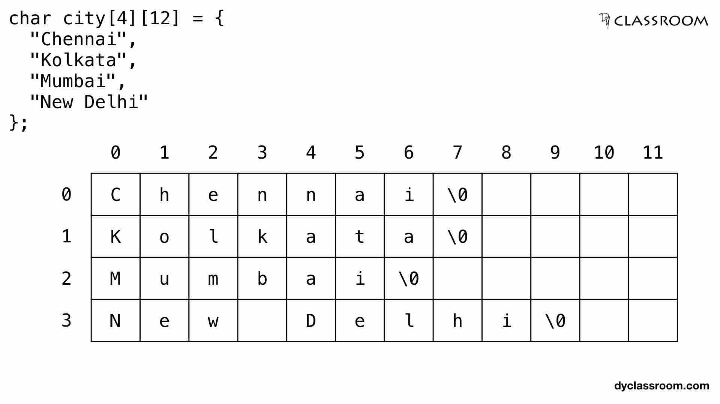

Slide 50
Initialization
The first subscript of the array i.e 3 denotes the number of strings in the array and the second subscript denotes the maximum length of the string.
Each character occupies 1 byte of data, so compiler 30 bytes (3*10) of memory for the above example.
The name of an array is a pointer to the 0th element of the array.
Therefore, if ch_arr points to address 1000 then ch_arr + 1 will point to address 1010.
ch_arr + 0 points to the 0th string or 0th 1-D array.
ch_arr + 1 points to the 1st string or 1st 1-D array.
ch_arr + 2 points to the 2nd string or 2nd 1-D array.
In general, ch_arr + i points to the ith string or ith 1-D array.

Slide 51
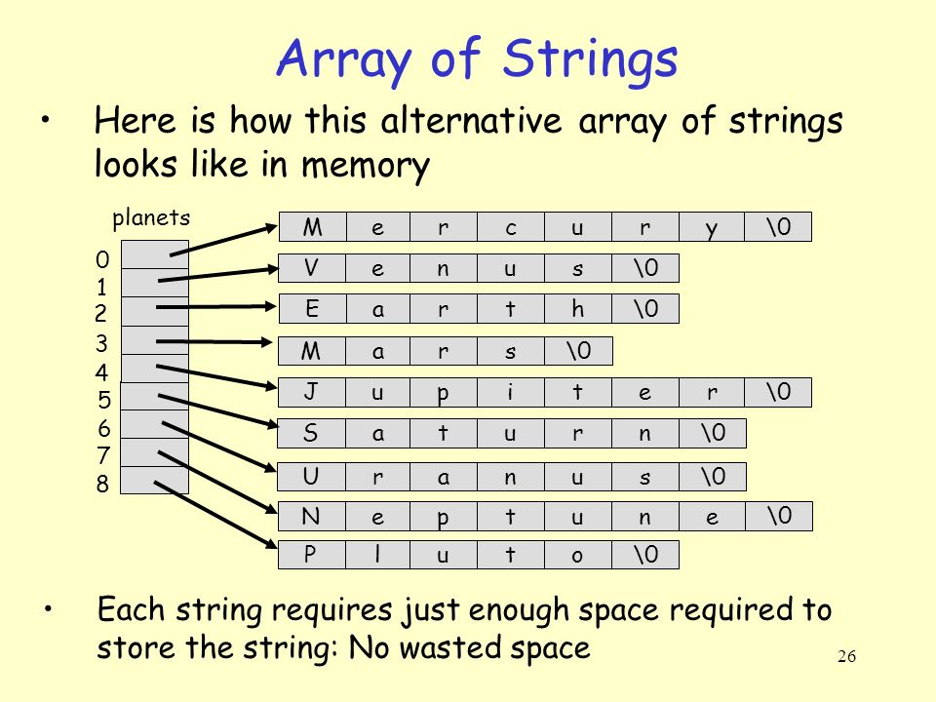
char planets[8][] = {"Mercury", "Venus", "Earth", "Mars", "Jupiter", ”Saturn”, ”Uranus”, ”Neptune”, “Pluto”};

Slide 52
Input and Output
Input
To accept input for a list of 5 names, we write
char name[5][31];
for (i = 0; i < 5; i++)
scanf(" %[^\n]s", name[i]);
The space in the format string skips leading whitespace before accepting the string.
char name[5][31] = {"Harry", "Jean", "Jessica", "Irene", "Jim"};
printf("%s", name[2]);
Output

Slide 53
Program that initializes 3 names in an array of strings and display them on to monitor
#include<stdio.h> #include<string.h>
main()
{
int i;
char names[3][10] = {“Alex”, “Phillip”,“Collins” };
for(i=0; i<3; i++) printf(“%s\n”,names[i]);
}
OUTPUT
Alex
Phillip
Collins

Slide 54
Search a name in a given list
#include<stdio.h>
#include<string.h>
int main()
{
char name[5][10],found[10];
int j,i,flag=0;
printf("Enter the names:\n");
for(i=0;i<5;i++)
scanf("%s",name[i]);
printf("Enter the name to be searched:");
scanf("%s",found);
for(i=0;i<5;i++)
{
if(strcmp(name[i],found)==0)
{ flag=1; break; }
}
if(flag==1)
printf("String found\n");
else
printf("\nString not found");
}
OUTPUT
Enter the names:
Alice
Ziya
Celene
Ronald
Bob
Enter the name to be searched: Ram
String not found

Slide 55
Sorting of strings
#include<stdio.h>
int main()
{
int i,j,n;
char str[20][20],temp[20];
puts("Enter the no. of string to be sorted:"); scanf("%d",&n);
for(i=0;i<=n;i++) gets(str[i]); for(i=0;i<=n;i++)
{
for(j=i+1;j<=n;j++)
{
if(strcmp(str[i],str[j])>0)
{
strcpy(temp,str[i]); strcpy(str[i],str[j]); strcpy(str[j],temp);
}
}
}
printf("The sorted strings are:\n");
for(i=0;i<n;i++)
puts(str[i]);
}
OUTPUT
Enter the no. of string to be sorted:3
Ziya
Ronald
Bob
The sorted strings are:
Bob
Ronald
Ziya

Slide 56
References
https://www.tutorialspoint.com/c_standard_library/c_function_
slideshare.com

Slide 57
THANK YOU

